Slide 1


Machine Learning
Part of Future Connect Media’s IT Course
By Abhishek Sharma

Slide 2
Principle Component Analysis

Slide 3
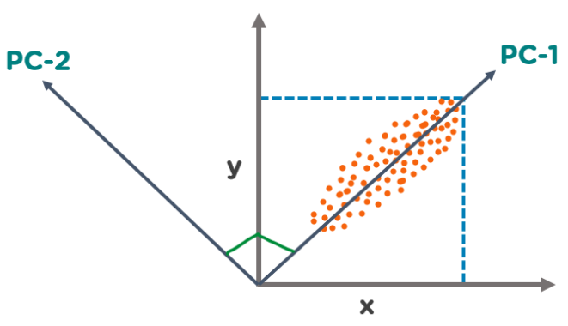
PCA
Principal Component Analysis is a popular unsupervised learning technique for reducing the dimensionality of data.
It increases interpretability yet, at the same time, it minimizes information loss.
It helps to find the most significant features in a dataset and makes the data easy for plotting in 2D and 3D.
PCA helps in finding a sequence of linear combinations of variables.

Slide 4
Principle components
The Principal Components are a straight line that captures most of the variance of the data.
They have a direction and magnitude.
Principal components are orthogonal projections (perpendicular) of data onto lower-dimensional space.

